Slide 1
Tasks 41-50

Slide 2
Task 41
Solve Exercise 12, Chapter 2

Slide 3
Task 42
Solve Exercise 2, Chapter 12

Slide 4
Task 43
Solve Exercise 3, Chapter 12

Slide 5
Task 44
Solve Exercise 8, Chapter 12

Slide 6
Task 45
Solve Exercise 13, Chapter 12

Slide 7
Task 46
Consider transformation rules R1-R12 from Lecture 10
Provide the shortest possible proof for the example considered at Lecture 10 (that consisting of 14 steps)

Slide 8
Task 47
Derive a resolution proof for the example mentioned in Task 46

Slide 9
Task 48
Using the truth tables, show that the reasoning rules applied in the resolution proofs are always valid

Slide 10
Task 49
Consider standard fuzzy logic system where
  The degree of negation ¬P equals to one subtracted by the degree of P
  The degree of conjunction P ∧ Q equals to the minimum of the degree of P and the degree of Q
  The degree of disjunction P ∨ Q equals to the maximum of the degree of P and the degree of Q
Show that in this system a fuzzy de Morgan law holds, that is: the degrees of formulas
¬(P ∧ Q) and ¬P ∨ ¬Q
are always the same

Slide 11
Task 50
Consider fuzzy logic system where
  The degree of negation ¬P equals to one subtracted by the degree of P
  The degree of P ∧ Q equals to the multiplication of the degree of P and the degree of Q
How should we define the formula for the degree of disjunction to obtain a law analogous to that from Task 49?

Slide 12
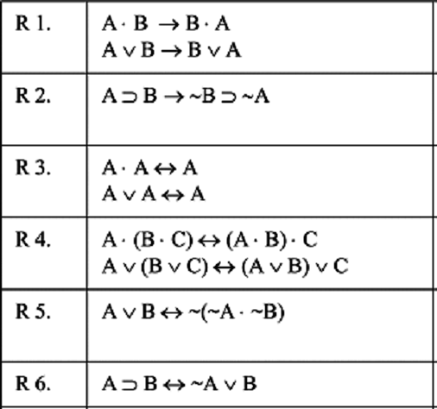
Transformation rules for logic problems (Newell & Simon, 1961)
“⋅” denotes conjunction
“∨” denotes disjunction
“∼” denotes negation
“⊃” denotes implication
“→” and “↔” denote legal replacement

Slide 13
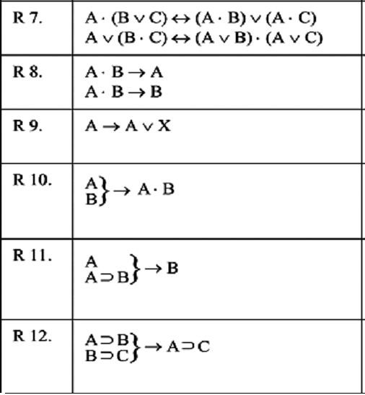
Transformation rules for logic problems (Newell & Simon, 1961)
Modus Ponens (Detachment)
Chaining

Slide 14
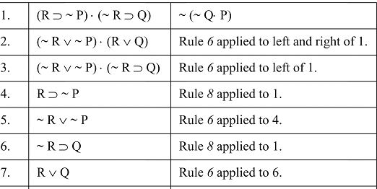
A proof of a theorem in propositional calculus (Newell & Simon, 1961)

Slide 15
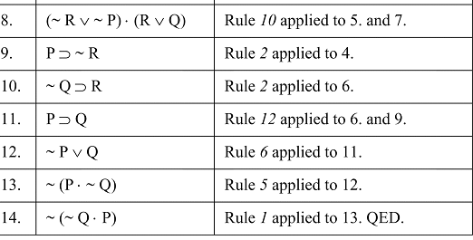
A proof of a theorem in propositional calculus (Newell & Simon, 1961)

Slide 16
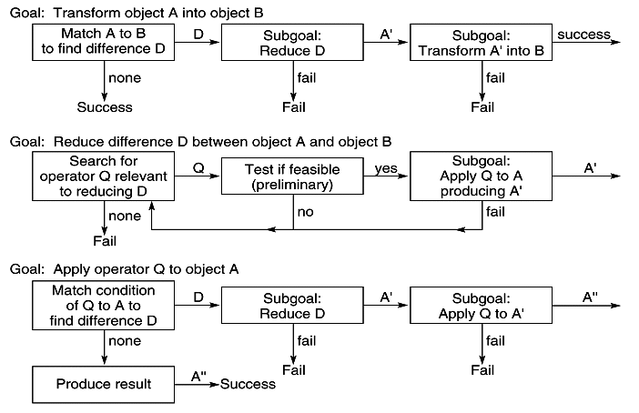
Flow charts for General Problem Solver (Newell & Simon, 1963)

Slide 17
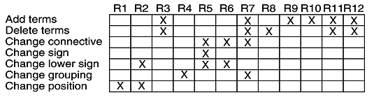
Table of connections for GPS (Newell & Simon, 1963)
X means some variant of the rule is relevant
GPS will pick the appropriate variant

Slide 18


Slide 19
RESOLUTION THEOREM PROVING

Slide 20
Resolution refutation proof
Put the premises or axioms into clause form (CNF-form)
Add the negation of what is to be proved, in clause form, to the set axioms
Resolve these clauses together, producing new clauses that logically follow from them
Produce a contradiction by generating the empty clause

Slide 21
Example
We wish to prove that
“Fido will die”
from the statements that
“Fido is a dog”
and
“all dogs are animals”
and
“all animals will die”

Slide 22
Applying modus ponens to the corresponding predicates
All dogs are animals:
∀(X)(dog(X)→animal(X))
Fido is a dog:
dog(fido)
Modus ponens and {fido/X} gives:
animal(fido)
All animals will die:
∀(Y)(animal(Y)→die(Y))
Modus ponens and {fido/Y} gives:
die(fido)

Slide 23
Reasoning by resolution
∀(X)(dog(X)→animal(X)) | ¬dog(X)∨animal(X)
dog(fido) | dog(fido)
∀(Y)(animal(Y)→die(Y)) | ¬animal(Y)∨die(Y)
¬die(fido) | ¬die(fido)
We show that the following is false:
(¬dog(X)∨animal(X))∧(dog(fido))∧ (¬animal(Y)∨die(Y))∧(¬die(fido))

Slide 24
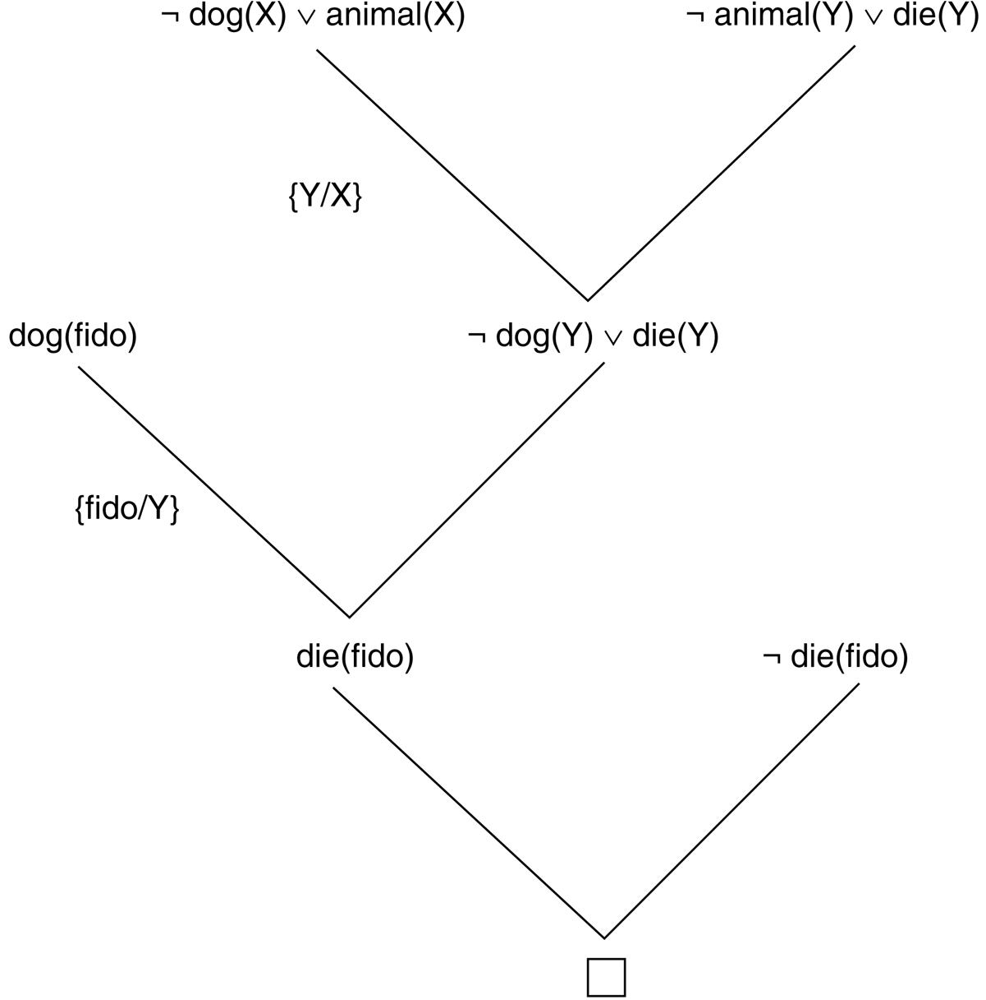
Resolution proof

Slide 25
Summary
The resolution refutation proof procedure answers a query or deduces a new result by reducing the set of clauses to a contradiction, represented by the null clause ()
The contradiction is produced by resolving pairs of clauses from the database
If a resolution does not produce a contradiction directly, then the clause produced by the resolution, the resolvent, is added to the database of clauses and the process continues

Slide 26
Binary Resolution Procedure
Suppose
a∨¬b and b∨c
are both true statements
One of literals b and ¬b must be false
Therefore, one of literals a and c is true
As a conclusion, a∨c is true
a∨c is the resolvent of the parent clauses a∨¬b and b∨c

Slide 27
Example
Suppose we have axioms
a←b∧c
b
c←d∧e
e∨f
d∧¬f
We want to prove a

Slide 28
Reducing to the clause form
a←b∧c
a∨¬(b∧c) by l→m ≡ ¬l∨m
a∨¬b∨¬c by de Morgan’s law

Slide 29
Final clause form
a←b∧c | a∨¬b∨¬c
b | b
c←d∧e | c∨¬d∨¬e
e∨f | e∨f
d∧¬f | d
 | ¬f

Slide 30
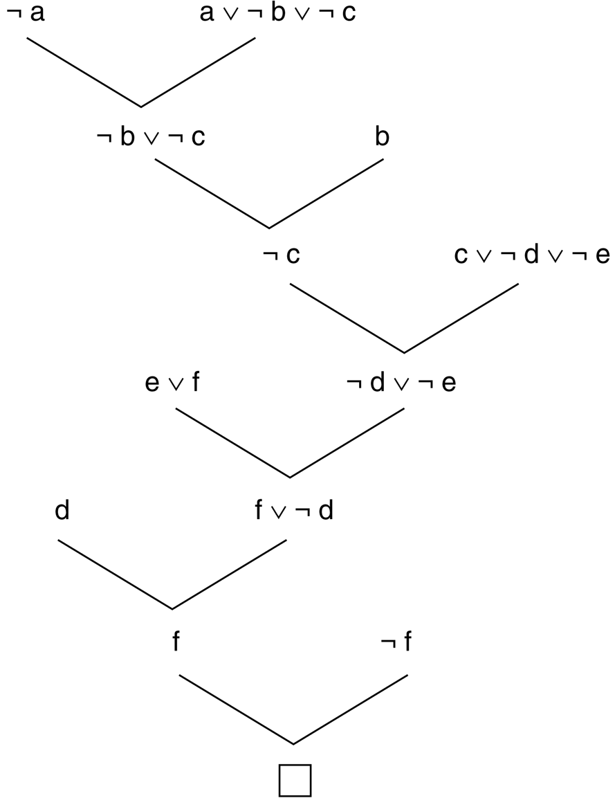
Resolution proof

Slide 31
Yet another example…
Anyone passing his history exams and winning the lottery is happy. But anyone who studies or is lucky can pass all his exams. John did not study but he is lucky. Anyone who is lucky wins the lottery. Is John happy?

Slide 32
Predicate Calculus
Anyone passing his history exams and winning the lottery is happy
∀X(pass(X,history)∧win(X,lottery)→happy(X))
Anyone who studies or is lucky can pass all his exams
∀X∀Y(study(X)∨lucky(X)→pass(X,Y))
John did not study but he is lucky
¬study(john)∧lucky(john)
Anyone who is lucky wins the lottery
∀X(lucky(X)→win(X,lottery))

Slide 33
Clause form
Premises:
¬pass(X,history)∨¬win(X,lottery)∨happy(X)
¬study(Y)∨pass(Y,Z)
¬lucky(W)∨pass(W,V)
¬study(john)
lucky(john)
¬lucky(U)∨win(U,lottery)
Negation of conclusion:
¬happy(john)

Slide 34
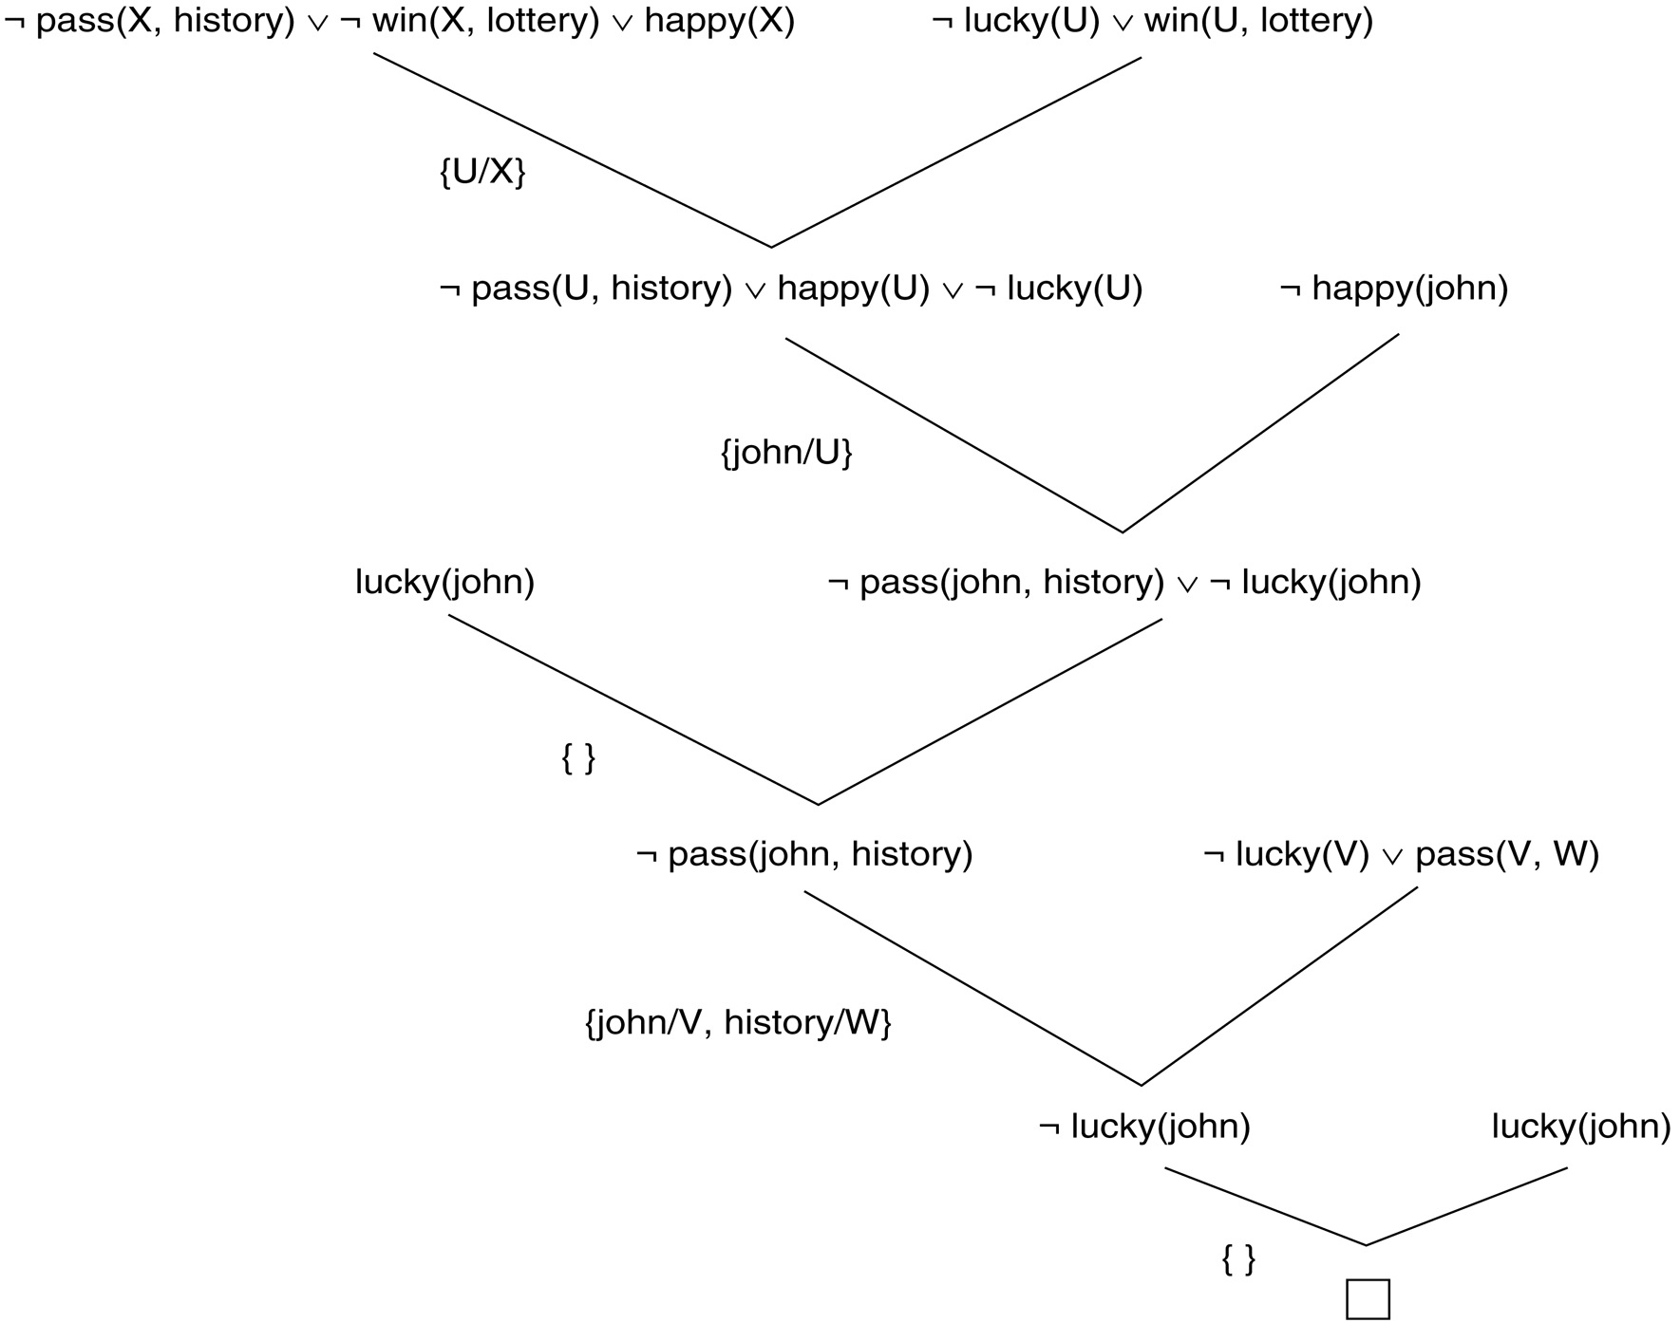
Resolution proof

Slide 35
THANK YOU

